Slide 1
Roz PhD Meeting 5th Feb
Anna David, Sebastien ourselin,
tom vercauteren, Rosalind Pratt,

Slide 2
Ethics
Should we include 3T?
?Chief investigator for ethics – Anna vs Seb
Sample size
Additional imaging sequences – how much do I need to say? Do we want diffusion weighted imaging, proton spectroscopy, time of flight scanning etc
How technical do I need to be? (novel image computing techniques, surgical planning software and Gift-Cloud)
Other comments
Notes:
----- Meeting Notes (05/02/15 15:37) -----
1.5 or 3T
Safety of both
Go talk to David re safety
CI - Anna David
Consent - Me, Anna, Giles, research MW, Ruwan, George, FMU staff with GCP
Sample size 700 OK. Fair representation rare disease, machine learning purposis (2-3/wk, 60 acceptance, approx 700 over 7 years)
Can keep extra sequences vague eg protocols (DW, TOF etc)
Technical
----- Meeting Notes (05/02/15 15:43) -----
Technical information - technical
Talk to Tom re ethics for Leuven (Gift-cloud)
Clinical protocol
Research part will be extra scanning etc.

Slide 3
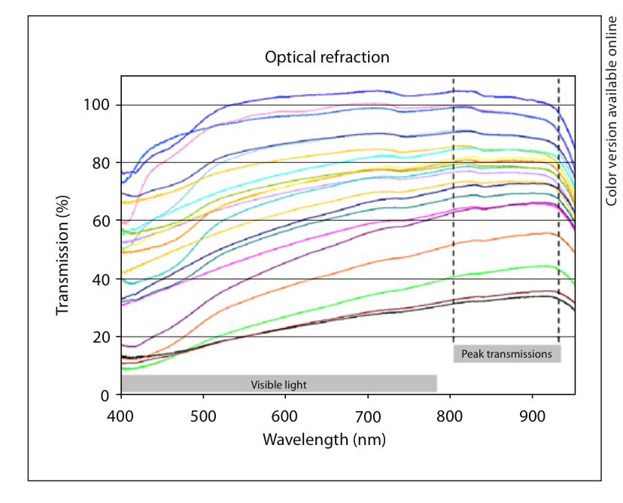
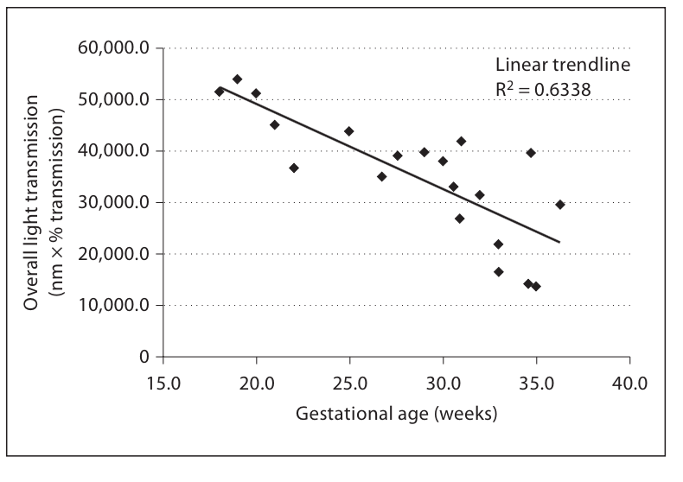
Optical Properties of Human Amniotic Fluid: Implications for Videofetoscopic Surgery Shaun A. Steigmana Shaun M. Kunisakia Louise Wilkins-Haugb Tamara C. Takoudesc Dario O. Fauzaa
21 samples, 19-36/40
% of light transmission through the fluid using an integrated spectrometer covering wavelengths of 400–950 nm
Peak optical refraction 848.1 8 +/- 52.3 nm
Statistically significant inverse relationship existed between gestational age and overall light transmission.
Notes:
----- Meeting Notes (05/02/15 15:56) -----
Change in optical properties during fetoscopy - samples at different times
Can you improve visualisation - design of new scopes

Slide 4
Optical properties amniotic fluid
Wavelengths in the near-infrared spectrum, or at least at the highest limits of the visible would be the ideal choices for light transmission within the pregnant human uterus, regardless of gestational age
Cumulative reflection might increase over larger focal distances
How can this impact clinical practice
Design of new scope
Diagnostic/clinical application
DW Ruwan Friday
We have sheep amniotic fluid and a new spectrometer in Mallet Place…

Slide 5
Infrared fetoscopy in Sheep (F Luks, J Deprest 1994)
Research done due to concerns re visible light damaging developing eye
Light WL >780nm, 93% 1100nm
Standard endoscopic CCD camera
Excellent visualization with good resolution
Loss of colour and therefore loss of small blood vessels
Notes:
----- Meeting Notes (05/02/15 15:56) -----
?relation to photoacoustics
?improve imaging if bleeding - how much bleeding makes it impossible to see? look at acoustic properties, can we imporve imaging with bleeding
?change in properties when mixed with flush fluid
What changes in the amniotic fluid after laser??? ?Implications for fetus

Slide 6
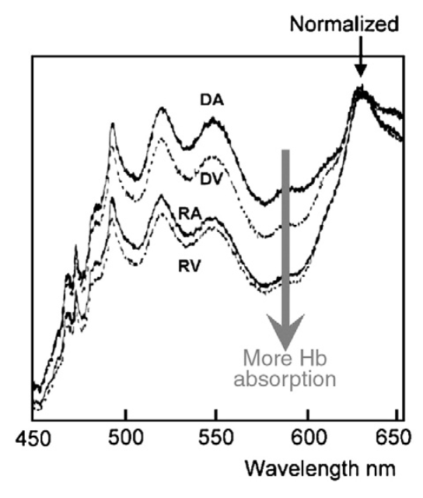
Reflectance spectrometry for real-time hemoglobin determination of placental vessels during endoscopic laser surgery for twin-to-twin transfusion syndrome, F. Luks et al 2009
Spectral analysis of the reflected light through the endoscope
Reflection captured through a 630-μm–diameter optic fiber coupled to a fixed grating spectrometer
It is possible to differentiate donor from recipient placental using a noninvasive and real-time method.
May allow instant endoscopic Hb determination for laparoscopic procedures as well.

Slide 7
Lit Review - Imaging the placental vasculature in vivo
TA USS
Colour doppler (4 studies)
Doppler velocimetry (coloured doppler)
Three-dimensional ultrasonic angiography using Advanced Dynamic Flow software
USS Contrast
Micro-bubbles
Fetoscopy
Fetoscopic mapping
Fluorescene endoscope (in Rabbits)
Intra-amniotic Doppler
MRI
Nil

Slide 8
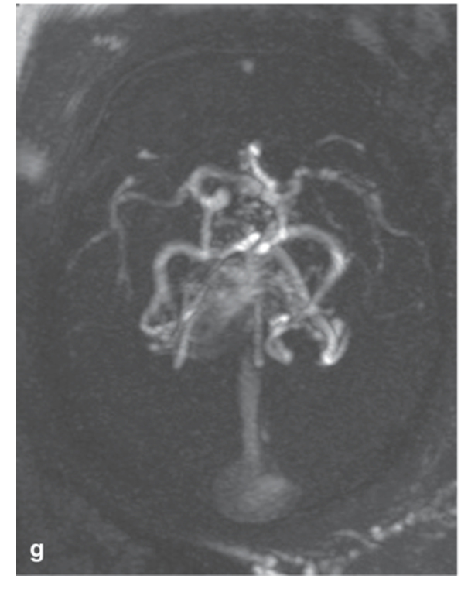
Why not MRI Placenta vasculature?
Prenatal Diagnosis of Cerebral Venous Pathologies: Findings in Diffusion-Weighted Imaging (DWI), Time-of-Flight (TOF), and Gradient-Echo Sequences, A. Dinçer 2013
?TOF/phase contrast in placenta
MRA demonstrates a positive correlation between placental blood vessel volume and fetal size (ex vivo – post delivery contrast MRI)
?Lit review of vascular imaging in fetus
Axial thick MIP of 2D TOF
Notes:
----- Meeting Notes (05/02/15 16:10) -----
Sjoerd Vos - MR physasist, diffusion imaging expert
(opposite lab)
Speak to him re possibility of TOP
Lit rv for vascular imaging in fetus
What useful for....
Plac - acreta, IUGR, abruption, TTTS etc
Development nec ent
etc...

Slide 9
Admin
PPIAG confidentiality agreement
PPIAG minutes
Honorary contract – need ID UCLH, computer access
Risk assessment
Annual leave (26-27th Feb, 2-3rd March)

