Slide 1
PhD Meeting 1st May 2015
Rosalind Pratt
Anna David
Sebastien Ourselin
Tom Vercauteren

Slide 2
Agenda
Review
Ethics
TTTS ideas

Slide 3
Review
Feedback from presentation/review (second draft)?
IFMSS abstract submitted

Slide 4
Ethics
IRAS nearly done
?change to include healthy volunteers
Pt info leaflets done
Developing generic Fetal MRI information leaflet

Slide 5
Improving clinical outcome in TTTS
?Survival
?Long term outcome – neurodevelopmental, other health related outcomes
What literature is there on MRI changes TTTS/Laser and their clinical implications?
?Role of functional imaging
No long term outcome studies including MRI/DWI imaging (that I’ve found so far)

Slide 6
TTTS – MRI findings in literature
Recipient -
Cerebral venous sinus enlargement
Recipient -Lung lesions CCAM
Recipient – dilated renal collection system
Recipient - Cardiomegaly/hydrops
Both - Cerebral malformations – PVL, IVH
Donor -
Hypoplastic lungs
DWI – brain lesions after laser

Slide 7
TTTS Long term outcome studies
Lopriore 2009
212 TTTS pregnancies treated laser
30% mortality
18% neurodevelopmental impairment
RF – increased GA at time of laser, Increasing Quintero score, Prematurity, low birth weight
Eurofetus – 12% neurological morbidity
Metal analysis – cerebral palsy 3-12%, neurodevelopmental impairment 7-18%
Notes:
Lopriore, E. et al. Risk factors for neurodevelopment impairment in twin-twin transfusion syndrome treated with fetoscopic laser surgery. Obstet. Gynecol. 113, 361–6 (2009).
1. van Klink, J. M. M. et al. Cerebral Injury and Neurodevelopmental Outcome in Twin-Twin Transfusion Syndrome. Curr. Obstet. Gynecol. Rep. 2, 240–248 (2013).

Slide 8
DWI fetal brain
T2 and DWI of fetal brain shortly after laser
N=30. MRI 1-5 days post laser.
6 had bleed, 3 had diffusion ischaemic changes
With iscahemic changes, 1 died, MRI showed remaining 2 had brain atrophy 28-32 weeks compatible with infarct – both TOP.
Conclusions
DWI can demonstrate cerebral damage immediately after FLC.
Larger cohorts are needed to determine the role of fetal MRI in the prenatal assessment and follow-up of patients with TTTS.
Notes:
1. Weisz, B. et al. Early detection by diffusion-weighted sequence magnetic resonance imaging of severe brain lesions after fetoscopic laser coagulation for twin-twin transfusion syndrome. Ultrasound Obstet. Gynecol. 44, 44–9 (2014).

Slide 9
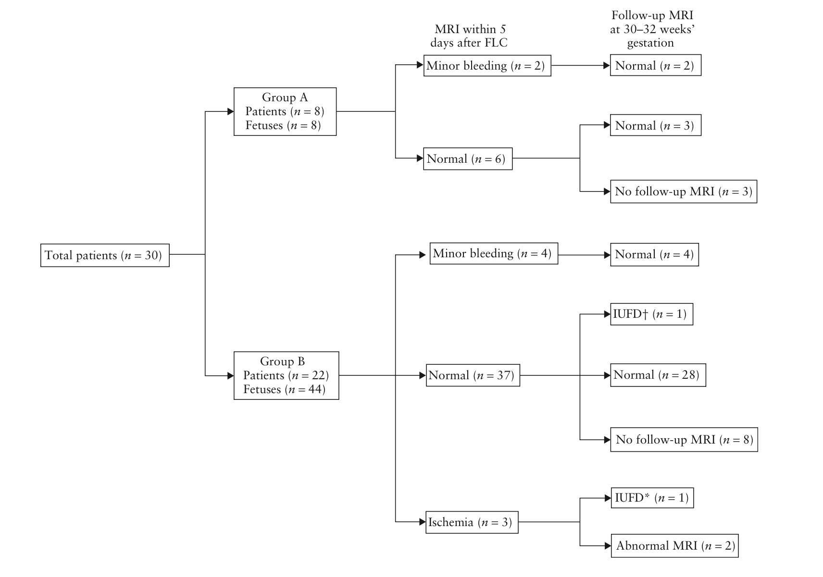

Slide 10
Gest laser | Gest MRI | Laser to MRI (Days) | Recipient MRI | Donor MRI | Outcome Recipient | Outcome donor | Notes
24+4 | 27+5 | 22 | NAD | Slightly small brain and slightly immature in gyral development. No focal lesions.
18+3 | 22+2 | 27 | NDA | Smaller calvarial size and brain volume. No infarct/haemorrhage.
18+5 | 25+0 | 44 | NAD | NAD
19+0 | 24+1 | 36 | NAD | NAD
23+4 | 28+5 | 36 | RIP | NAD | RIP 25+3 |  | DCTA triplets - triplet 1 singleton, 2 and 3 MCDA. Triplet 1 - NAD MRI
17+3 | 24+4 | 50 | NAD | NAD
25+3 | 31+3 | 42 | NAD | NAD |  |  | TAPS 32+4
25+4 | 29+5 | 29 | NAD | NAD |  |  | 31+2 - ex donor anaemic and hydropic - delivered .
17+0 | 23+2 | 44 | NAD | NAD |  | RIP 27+0 | Rpt MRI 31+2 - surviving ex-recipient brain NAD.
18+0 | 23+6 | 41 | NAD | NAD
21+0 | 25+6 | 34 | Prominent posterior horn left lateral ventricle | Prominence right germinal matrix over caudate nucleus, not overtly haemorrhagic.
17+2 | 31+2 | 98 | NAD - very early to RIP, no DWI. | RIP |  | RIP 31+2 | Laser at Kings. PPROM 18+0. Donor - severe IUGR, ventriculomegaly20/40,RIP 31+2.
24+3 | 27+4 | 22 | NAD | NAD |  |  | Inter-twin membrane rupture 31+4
19+0 | 23+0 | 28 | NAD | Microcephaly and ventricular dilatation suggestive of global malformation 2ndry to early insult |  | Selective TOP 31+5 | Laser at Kings
27+2 | 30+3 | 22 | NAD | Ventriculomegaly |  |  | Laser at Kings
16+5 | 23+6 | 50 | RIP | NAD | RIP 18+4
19+2 | 24+1 | 34 | NAD | NAD | RIP 24+5
Notes:
Death one twin – 4 cases (one TOP) 4/14 29%
MRI – Normal both twins – 8 cases 57%
- Abnormal findings – One global abnormality secondary to ealry insult – Donor (TOP)
- Two smaller brains ?significance – Donor
- One prominent germinal matrix – not overtly haemorrhagic – Donor
- One prominent posterior horn left ventricle ?significance – recipient
No neonatal MRI
No long term follow up

Slide 11
Data from MRI post Laser
Lasers done UCH N=42
MRI post laser N = 17 (3 lasers done at King’s)
Death of one twin/triplet – 6 cases (one TOP) 6/17 35%
MRI
Normal both twins – 9 cases 53%
All RIP prior to MRI – other twin NAD
2 x RIP after normal MRI (4 and 26 days later)
Abnormal findings
One global abnormality secondary to early insult - Donor (TOP)
Two smaller brains – Donor
One ventriculomegaly (mild) - Donor
One prominent germinal matrix – not overtly haemorrhagic – Donor (?significance)
One prominent posterior horn left ventricle – Recipient (?significance)
No neonatal MRI (that I’ve found yet)
?long term follow up
?Clinical significance of some findings

Slide 12
Ideas – TTTS Imaging
Placental angiography
Placental perfusion – ASL, BOLD, DWI
BOLD fetal brain/other organs (?liver) ?difference recipient/donor ?predictive outcome
Renal perfusion - ?decreased in donor (renin-angiotensis system)
DWI fetal brain before and after laser - ?change caused by laser
Long term follow up needed – clinical relevance of changes seen – function brain MRI, T2/1 weighted MRI
Notes:
Blood oxygen dependent MRI

Slide 13
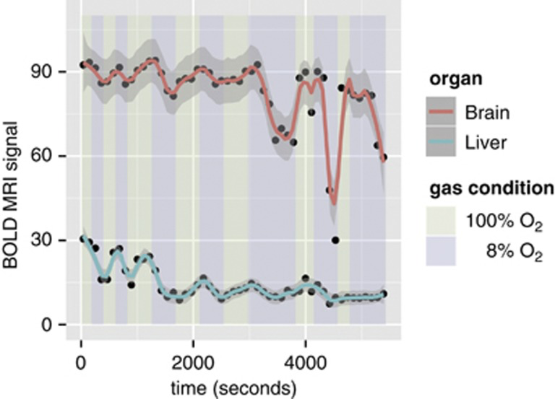
Fetal BOLD MRI
Blood-oxygen level dependent MRI
Study has shown increasing maternal inspired O2 significantly changed placental but not fetal brain signal (corresponds pO2)¹
In mice decreasing inspired oxygen 100% to 8% decreased liver signal 44% and brain by 12%²
French trial just started recruiting to study difference in BOLD signals between normal and IUGR placentas
Notes:
Huen, I. et al. Absence of PO2 change in fetal brain despite PO2 increase in placenta in response to maternal oxygen challenge. BJOG 121, 1588–94 (2014)..
Cahill, L. S., Zhou, Y.-Q., Seed, M., Macgowan, C. K. & Sled, J. G. Brain sparing in fetal mice: BOLD MRI and Doppler ultrasound show blood redistribution during hypoxia. J. Cereb. Blood Flow Metab. 34, 1082–8 (2014).

Slide 14
Placental perfusion
Diffusion weighted imaging allowing calculation of placental perfusion fraction – perfusion fraction 21% with IUGR, 32% in normal pregnancies p=0.005¹
ASL flow-sensitive alternating inversion recovery (FAIR)and intravoxel incoherent motion (IVIM) both showed significant difference between SGA and normal birth weight neonates²
Diffusion studies within fetal kidneys, brain, lungs…
Notes:
Sohlberg, S. et al. MRI estimated placental perfusion in fetal growth assessment. Ultrasound Obstet. Gynecol. (2015). doi:10.1002/uog.14786
Derwig, I. et al. Association of placental perfusion, as assessed by magnetic resonance imaging and uterine artery Doppler ultrasound, and its relationship to pregnancy outcome. Placenta 34, 885–91 (2013).

Slide 15
Ideas
Lit review – functional imaging of fetus and placenta
What forms of functional imaging are being used and for what
How could we use them in TTTS
To further study the disease process
To improve prognostic counseling
?As outcome measure for future studies

