Slide 1
PhD Meeting 20th March 2015
Rosalind Pratt
Anna David
Sebastien Ourselin
Tom Vercauteren

Slide 2
Agenda
Fetal Imaging for intervention; the future of surgical planning and intraoperative guidance
Fetal angiography

Slide 3
Imaging for intervention; the future of surgical planning and intraoperative guidance
Imaging – MRI, CT, USS
Segmentation – automatic,/manual segmentation of structures of interest, eg in renal surgery - kidney, tumour, blood vessels, ureters
Virtual 3D model +/- surface smoothing, coloring of different structures
Preoperative simulation – measure, plan, simulate specific procedure, discuss in MDT meeting
Intraoperative navigation – display images in operating room, map to patient anatomy

Slide 4
3D modeling - brain
Movement
2 step reconstruction-alignment methodology – initial 3D model from scattered slices then refining alignment¹
Slice intersection motion correction method²
Segmentation
Spatiotemporal atlas^{4,5}
Probability map⁴
Patch-based^{5,6}
Notes:
Studholme, C. & Rousseau, F. Quantifying and modelling tissue maturation in the living human fetal brain. Int. J. Dev. Neurosci. 32, 3–10 (2014).
Kim, K. et al. Intersection based motion correction of multislice MRI for 3-D in utero fetal brain image formation. IEEE Trans. Med. Imaging 29, 146–58 (2010).
Keraudren, K., Kyriakopoulou, V., Rutherford, M., Hajnal, J. V. & Rueckert, D. Localisation of the brain in fetal MRI using bundled SIFT features. Lect. Notes Comput. Sci. (including Subser. Lect. Notes Artif. Intell. Lect. Notes Bioinformatics) 8149 LNCS, 582–589 (2013).
Scott, J. A. et al. Growth trajectories of the human fetal brain tissues estimated from 3D reconstructed in utero MRI. Int. J. Dev. Neurosci. 29, 529–36 (2011).
Wright, R. & Vatansever, D. Age dependent fetal MR segmentation using manual and automated approaches. Work. Perinat. … 97–104 (2012). at <http://www.cs.unc.edu/Research/MIDAG/defmreps/styner_www/public/FetalMRI_IBIS/PDF/MICCAI Workshop on Perinatal and Paediatric Imaging PaPI 2012 2012 Wright.pdf>
Keraudren, K. et al. Automated fetal brain segmentation from 2D MRI slices for motion correction. Neuroimage 101, 633–43 (2014).
Kainz, B. et al. Motion Corrected 3D Reconstruction of the Fetal Thorax from Prenatal MRI. Med. Image Comput. Comput. Interv. – MICCAI 1–8 (2014). doi:10.1007/978-3-319-10470-6_36

Slide 5
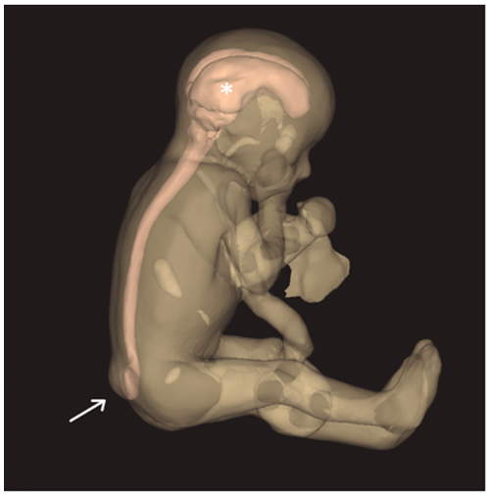
Clinical application of 3D models
Werner et al^{1,2}
3D solid models achondroplasia, cervical lymphangioma, sacroccygeal teratoma, encephalocele, spina bifida, cleft lip
Figure 1
Figure 2
Figure 1: Sacrococcygeal teratoma (white arrow) on three dimensional USS and MRI (A), virtual 3D model (B) and physical model ©¹.
Figure 2: 3D virtual model from MRI showing lumbosacral meningomyelocele (arrow) and ventriculomegaly (astrix) in a case of Chiari II malformation at 29 weeks gestation².
Notes:
Werner, H., Rolo, L. C., Araujo Júnior, E. & Dos Santos, J. R. L. Manufacturing models of fetal malformations built from 3-dimensional ultrasound, magnetic resonance imaging, and computed tomography scan data. Ultrasound Q. 30, 69–75 (2014).
Werner, H., Lopes, J., Tonni, G. & Araujo Júnior, E. Physical model from 3D ultrasound and magnetic resonance imaging scan data reconstruction of lumbosacral myelomeningocele in a fetus with Chiari II malformation. Child’s Nerv. Syst. d, 5–7 (2015).

Slide 6
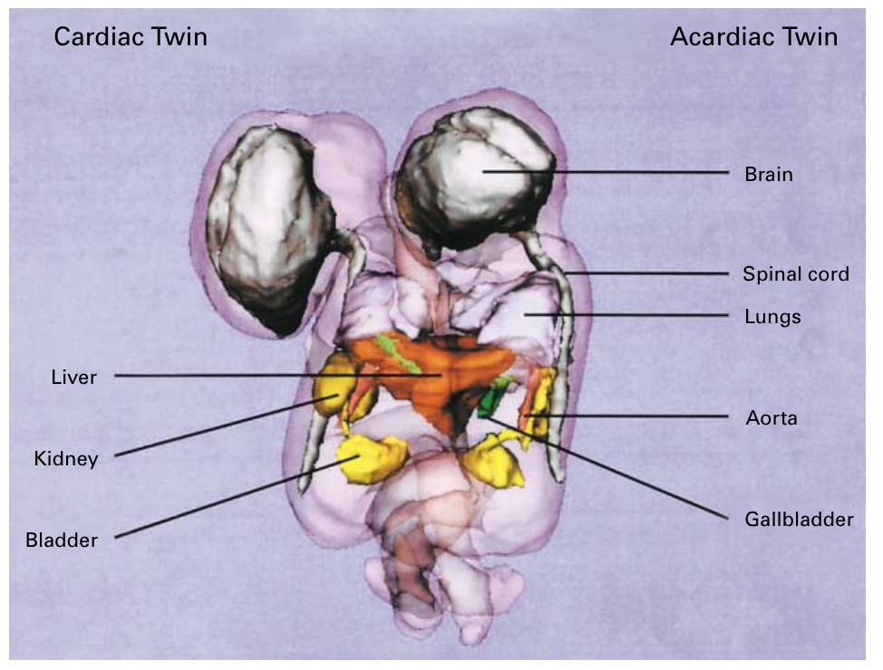
More complex anatomy using manual segmentation
Manual segmentation, to demonstrate potential¹
3D MRI model with manual segmentation in case of conjoined twins complicated by twin reversed-arterial-perfusion sequence to plan immediate post-delivery separation²
Figure 1
Figure 1: Segmentation of the brain, eyes, lungs, heart and urinary bladder in two different views of a fetus 3D model¹
Figure 2: 3D MRI based computer model of conjoined twins, revealing two separate biliary drainage systems (green) within the fused liver (orange). Other organs shown include lungs (light purple), kidneys (dark yellow), bladder (bright yellow) and CNS (gray)².
Figure 2
Notes:
Anquez, J. et al. Interest of the Steady State Free Precession (SSFP) sequence for 3D modeling of the whole fetus. Annu. Int. Conf. IEEE Eng. Med. Biol. - Proc. 771–774 (2007). doi:10.1109/IEMBS.2007.4352404
Norwitz, E. R. et al. Separation of conjoined twins with the twin reversed-arterial-perfusion sequence after prenatal planning with three-dimensional modeling. N. Engl. J. Med. 343, 399–402 (2000).

Slide 7
Improved anatomical Understanding
Manually segmented 2D fetal MRI and production 3D model
Normal brain, hydrocephalus, periventricular hemorrhage, vein of Galen aneurysm
First demonstration of improved anatomic understanding from 3D model – 4 feeding vessels, not 2 (as seen 2D MRI and USS)
3D model of fetal skin (pink), brain (white) and vein of Galen aneurysm malformation (note 4 arterial feeding vessels in red, venous drainage blue)²⁹
Notes:
Schierlitz, L. et al. Three-dimensional magnetic resonance imaging of fetal brains. Lancet 357, 1177–1178 (2001).

Slide 8
Plan Delivery
Manual segmentation and 3D model
Simulation movie demonstrating fetal airway^{1,2}
4 cases of cervical tumours (3 lymphangiomas, 1 teratoma)
Plan delivery – no EXIT procedure
Facial profile on USS (a) and MRI (b), showing cervical lymphangioma at 27 weeks gestation. 3D reconstruction of the fetal airway and lung (c-e). Neonatal image (f)².
Notes:
Werner, H. et al. Virtual bronchoscopy in the fetus. Ultrasound Obstet. Gynecol. 37, 113–115 (2011).
Werner, H. et al. Virtual bronchoscopy for evaluating cervical tumors of the fetus. Ultrasound Obstet. Gynecol. 41, 90–94 (2013).

Slide 9
Surgical planning in twin-to-twin transfusion syndrome
Twins and intertwine membrane. 3D reconstruction of anterior placenta (red), which is rotated to expose recipient (blue) and donor (yellow) their cord insertion (arrows) and insertion of intertwine membranes (green line)¹.
Semi-automatic segmentation and 3D reconstruction on preoperative planning software designed for cranial application
Study anatomy, cord insertion, locate inter-twin membrane, plan point of entry, instrument reached target area at correct angle
Notes:
Luks, F. I., Carr, S. R., Ponte, B., Rogg, J. M. & Tracy, T. F. Preoperative planning with magnetic resonance imaging and computerized volume rendering in twin-to-twin transfusion syndrome. Am. J. Obstet. Gynecol. 185, 216–219 (2001).
SNN 3.0 Planning and Navigation Software, Mississauga, Ontario, Canada

Slide 10
Surgical Planning in other specialties
Laparoscopic – renal and liver resections
Pre-surgical planning
Communicating with patient and consent
Intra-operatively
The 3D reconstructed image in normal (A), and surface rendering (B) mode. These can be viewed from any angle¹.
Notes:
Komai, Y. et al. A novel 3-dimensional image analysis system for case-specific kidney anatomy and surgical simulation to facilitate clampless partial nephrectomy. Urology 83, 500–506 (2014).

Slide 11
Intra-operative Guidance
Difficult to view/subsurface structures, 3D instrument guidance
Limitations – 3D model needs manual alignment and scaling, need fixed point, overcoming anatomical deformity in surgery
Figure 1
Figure 2
Figure 1: The intraoperative fused reno-vasculature featuring the target segmental branch (white arrow)¹
Figure 2: Interactive intrausrigal guideance on Da Vinci robot providing an internal augmented reality view in the master vision system (a) and an external augmented reality view of the patient ©².

Slide 12
Challenges within Fetal Surgery
Improving MRI
Improved signal-to-noise, higher resolution
Contrast between structures
?blood vessels
Improved segmentation
All relevant areas of fetus and other pregnancy structures
Gestation specific
Intra-operative guidance
How to align imaging
Overcoming movement – maternal and fetal

Slide 13
Fetal Angiography

Slide 14
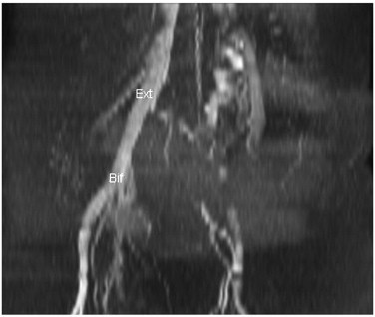
Determining uterine blood flow in pregnancy with magnetic resonance imaging
2D TOF MRA
Unable to measure total blood flow to uterus
Fig. 3 Two-dimensional spoiled gradient time-of-flight pelvic MR angiogram sequence in the coronal plane. The consistent identification of vessels with prograde flow was impeded with such acquisitions. Ext=right external iliac artery, Bif=bifurcation.
Notes:
Pates, J.A. et al., 2010. Determining uterine blood flow in pregnancy with magnetic resonance imaging. Magnetic resonance imaging, 28(4), pp.507–10. Available at: http://www.ncbi.nlm.nih.gov/pubmed/20061112 [Accessed March 19, 2015].

Slide 15
Prenatal Diagnosis of Cerebral Venous Pathologies
1.5T Siemens MRI, body array coil, free breathing
Gradient-echo T2*, diffusion weighted
2D TOF MRA TR/TE=31/8.2, flip angle=60°, section thickness 2.5mm, no gap, matrix 246x256, FOV 25cm, axial plane
2D TOF MRV – inferior saturation slab to saturate arterial inflow, 2sec/slice
Axial (g) and coronal (h) thick MIP of 2D TOF images showing the numerous feeders to the vein of Galen aneurysm
Notes:
Aksoy Ozcan, U. et al., 2013. Prenatal Diagnosis of Cerebral Venous Pathologies: Findings in Diffusion-Weighted Imaging (DWI), Time-of-Flight (TOF), and Gradient-Echo Sequences. Clinical Neuroradiology, 24, pp.165–171. Available at: http://link.springer.com/10.1007/s00062-013-0213-2.

Slide 16
Arterial spin labeling
Time-spatial labeling inversion pulse (Time-SLIP) MRA in adenomyosis
Blood flow toward the adenomyosis is abundant, and blood from the ascend- ing branch of the left uterine artery flows predomi- nantly to the adenomyosis, rather than to the placenta. Blood flow toward the placenta derived almost entirely from the right uterine artery.
Notes:
Yorifuji, T. et al., 2013. Time spatial labeling inversion pulse magnetic resonance angiography in pregnancy with adenomyosis. Journal of Obstetrics and Gynaecology Research, 39(10), p.n/a–n/a. Available at: http://doi.wiley.com/10.1111/jog.12088.

Slide 17
Renal Artery Stenosis
Non-contrast MRA
Balanced steady state procession time-spatial labeling inversion pulse
Figure 2
Figure 1
Figure 1: Time-SLIP flow-in techniques of three fusion images showing portal veins, hepatic artery with renal arteries, and hepatic veins ¹
Figure 2: A and B, Contrast-enhanced CTA (A) and time-spatial labeling inversion pulse unenhanced MRA (B) images show renal arteries are normal. There is strong anatomic correlation between two techniques with visualization of both second- and third-order renal vessels².
Notes:
Miyazaki, M. & Akahane, M., 2012. Non-contrast enhanced MR angiography: Established techniques. Journal of Magnetic Resonance Imaging, 35(1), pp.1–19.
Albert, T.S.E. et al., 2015. An International Multicenter Comparison of Time-SLIP Unenhanced MR Angiography and Contrast-Enhanced CT Angiography for Assessing Renal Artery Stenosis: The Renal Artery Contrast-Free Trial. American Journal of Roentgenology, 204(1), pp.182–188. Available at: http://www.ajronline.org/doi/abs/10.2214/AJR.13.12022.

