Slide 1
Oculo-Vestibular Recoupling Using Galvanic Vestibular Stimulation to Mitigate Simulator Sickness
Making people feel they are moving
Deliberately shocking the nervous system

Slide 2
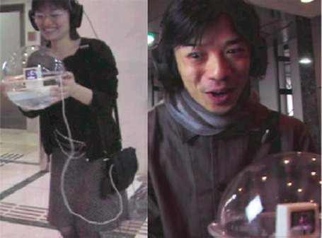
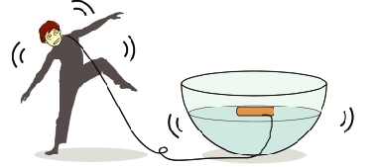
Vestibular Recoupling to a floating avatar
J Watanabe
Notes:
GVS artificially induces sensations of motion
J Watanabe used it in an art exhibit
Visitors were given an avatar in a bowl of water
They would experience what the avatar experienced as it rolled around in the bowl
Additional References:
Ruhl, A., & Lamers, M. H. (n.d.). Experiments with Galvanic Vestibular Stimulation in Daily Activities.

Slide 3
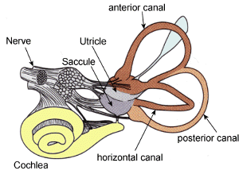
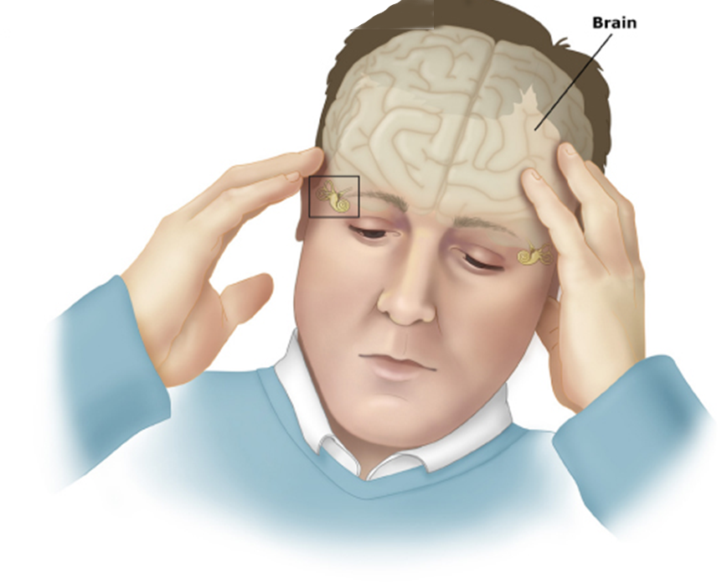
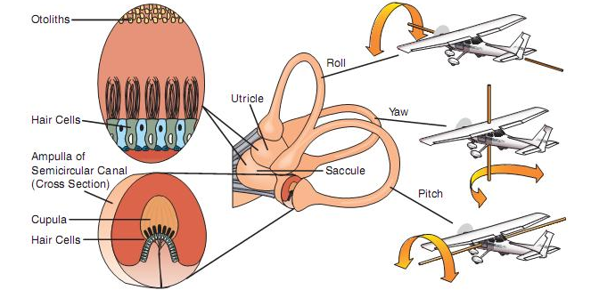
The Vestibular System
Notes:
Part of the head used to maintain balance
Above each ear
Vestibular system measures acceleration/g-force
Two sacs full of Otoliths measure tilts (Saccule, Utricle) with otoliths (technically translation but feels more like tilting…)
(otoliths are tiny particles suspended in fluid)
When the head moves these stimulate hair cells, which generate nerve impulses
Semi-circular canals (3) contain a gel which operates in a similar way and result in sensations of rotation
(This is why acoustic stimulation is also possible)
This paper discusses GVS as if it only stimulates the semi-circular canals, but GVS does not discriminate and other texts talk more about influcene on the otoliths.
Nerve impulses sent down nerve
Reinforcing what we know anecdotally, go to the same area of the brain as self-motion cues derived from visual stimuli
We can induce sensations by triggering the nerve with electric current
Additional Refernces:
Bacsi, A. M., Watson, S. R. D., & Colebatch, J. G. (2003). Galvanic and acoustic vestibular stimulation activate different populations of vestibular afferents, 114, 359–365. doi:10.1016/S1

Slide 4
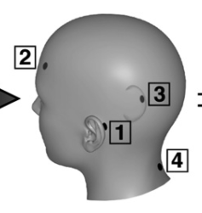
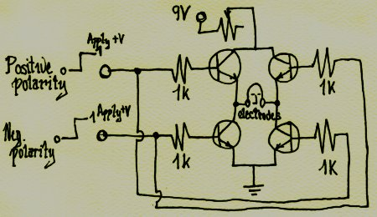
Galvanic Vestibular Stimulation
“…sensations of rocking or pitching, head and/or body tilt, and have ocular torsion – all characteristics of otolith system activation”
- http://www.frontiersin.org/Journal/10.3389/fneur.2011.00090/full
Notes:
Passing small currents through the bones behind the ear trigger the vestibular system
Currents are small (1-4ma)
(An LED keyring torch takes ~25mA)
So are voltages (7-9v) can be done with a battery
Resistance of the skin is ~1-4K – must be prepared either by damaging the surface or using thing such as conductive gels
How or what is being stimulated in the nerves is unknown
We can see:
Current
Frequency
Function
(And the difference between all of the above between the different electrodes)
All have an effect on the sensations, with some being uncomfortable and some barely noticeable
Experimenters use tools like those used to stimulate muscles, because they have many functions
The levels and frequencies involved however are not excessive at all
Simple circuits suffice
(one shown is actually an H-Bridge)
GVS has been known by doctors for a long time.
Since 1791, when Luigi Galvani and Count Allesandro Volta were experimenting with the electrical nature of the nervous system
These experiments led volta to develop the first voltaic cell – the battery
Is used in a number of places such as assessing motor system problems, and simulating microgravity for astronauts in training.
Additional References:
http://www.frontiersin.org/Journal/10.3389/fneur.2011.00090/full

Slide 5
OCULO-VESTIBULAR RECOUPLING — CEVETTE ET AL.
Can GVS be used to induce sensations of motion that correspond with visual stimuli in simulators?
Derive function to calculate signals from desired motion sensation
Create a rig to apply them in a simulator
Use the above to mitigate simulator sickness in test group
Notes:
Simulator sickness is a big problem
Predominant theory is that it is caused by intrasensory and intersensory discrepency
This is the same thing that frustrates binding and reduces the sense of presence
Other theories include
Not having strategies to cope with new environment (doesn’t explain why experienced aviators are more susceptible)
Sickness is caused by saccadic eye movements that are controlled by vestibular system (they don’t really comment on this)
Authors point out drugs are available but impractical
For many professions such as pilots the only treatment is exposure therapy
This has a relatively high success rate (60-80%)
But is unpleasant, and when pilots do wash out it is expensive
Assuming first theory of SS is true
Reduce intersensory conflict with GVS
Come up with a dose model for GVS
Integrate this with a flight simulator
Study whether pilots get ill
Additional References:
Cheung, B. (2001). Airsickness desensitisation for the Canadian Forces - A recommendation. Defence R&D Canada.
Deshmukh, S. P. (2007). DESENSITISATION OF AIRSICKNESS IN TRAINEE PILOTS BY PHYSICAL EXERCISE THERAPY, M(May), 37–42.

Slide 6
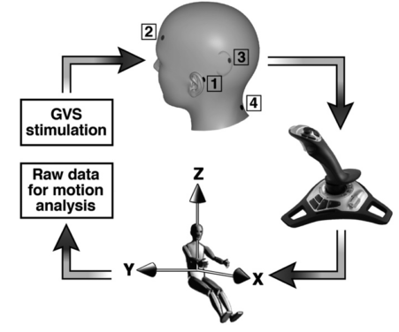
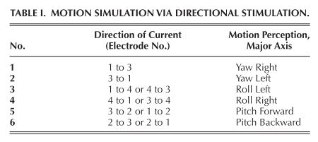
Creating the dose model
Notes:
Creating the dose model
Connected electrodes and a galvanic stimulator supporting four channels
Doses were applied at different currents to different electrode combinations
Don’t say explicitly but since stimulator is battery powered it is likely DC
While doses were applied, user would indicate their perception of their orientation/movemt by moving an avatar with a joystick to match their experiences

Slide 7
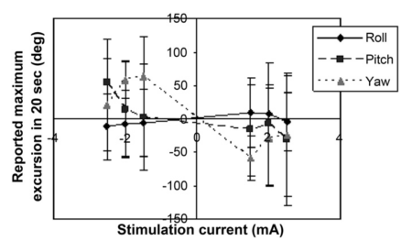
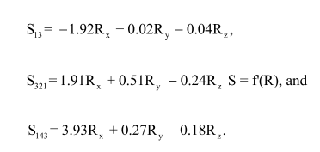
Mapping Stimulation to Perceived Motion
Notes:
These are the dose models they came up with….
Got these by performing linear curve fit through the plot of reported rotation vs current for the various electrode pairs
R is rotation in degrees per second, S is current in mA

Slide 8
The Experiment
Helicopter Training Simulator
21 Subjects with no history of motion sickness
Subjects experienced flight sim in normal operation
After a time, uncontrollable oscillations were added
Control group received GVS with noise
Test group received GVS based on models
Notes:
Helicopter simulator with 180 deg. FOV
The delay from the joystick control input was 100ms
The stimulator ran in parallel taking input from the main joystick directly
21 subjects between 19-31 were used
Was the same group as before
None of the subjects had any history of simulator sickness
Tests lasted 20 mins
5 mins acclimatisation
15 mins testing
During acclimatisation, virtual helicopter responded as normal (GVS *was* active during this period)
During test, sinusoid was imposed on joystick to rotate the helicopter outside users control, inducing motion sickness
For one group, the GVS was accurately mimicing the visual stimulation/control from joystick
For another, 1mA was applied to induce tingling but not a sense of motion
Standardized motion sickness questionaire was used to judge their response

Slide 9
Results
Notes:
These are the reported results for each group to the SSQ
Didn’t say if they actually made anyone vomit (probably did since this is disinct from nausea…)
Performed one-way ANOVA and showed considerable improvement for OVR group with low p-scores for many symptoms

Slide 10
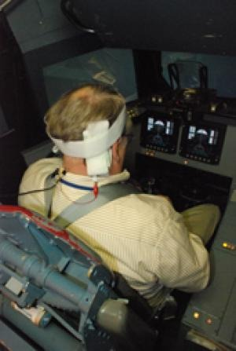
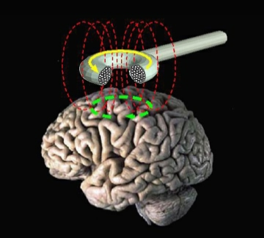
Discussion
Cevette, M. J., Stepanek, J., Cocco, D., Galea, A. M., Pradhan, G. N., Wagner, L. S., … Brookler, K. H. (2012). Oculo-Vestibular Recoupling Using Galvanic Vestibular Stimulation to Mitigate Simulator Sickness. Aviation, Space, and Environmental Medicine, 83(6)
Notes:
Can GVS be used for VR?
Authors assert that visual-vestibular contradictions are leading cause of SS
They assert that the operation of the vestibular system is known, and that the functions of raw/pitch etc are separate in different canals
Stimulation of nerves beyond the hairs however leads to perception of stimulation of both canals and a combined rotation
Authors also seem to speak with the opinion that sensations are easily controlled and correlate stronly with the visual stimuli
Others say that sensations due to GVS are a muddle of translation and rotational cues, and are a result both of stimulating the nerves and the head moving by reflex
Use in sit-down VR is limited due to difficulties in separating translational from rotational motion
If we could come up with a dose model however
Or even use something more advanced like direct magnetic nerve stimulation
Could greatly minimise motion sickness in VR
Further Reading:
http://www.maximintegrated.com/app-notes/index.mvp/id/3464 – Programmable Voltage Controlled Current Source

