Slide 1
Low Latency Rendering with Dataflow Architectures
Supervisor: Anthony Steed
Sebastian Friston
EngD VEIV

Slide 2
Why Latency?
The time between a user’s action, and the computer’s response to this action
Must be low to maintain the sense that the world is responding to the user – key to enabling presence
~10 ms has been demonstrated as the threshold for pointing and reaching tasks
For others, may be lower

Slide 3
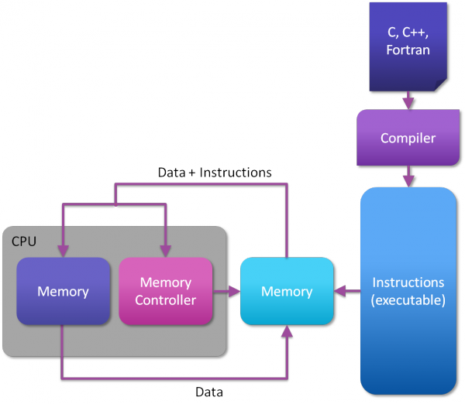
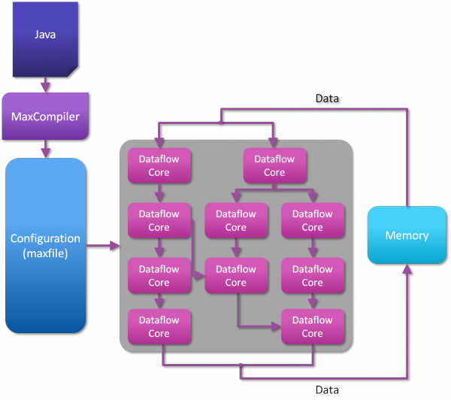
Dataflow Computing
True-parallel architecture for very high throughput applications

Slide 4
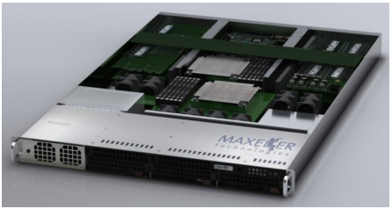
A Dataflow Image Generator
Our sponsor, Maxeler Technologies, builds platforms for processing dataflow algorithms
We will use this platform to create a new type of image generator for virtual reality

